Slide 1
Fachprojekt
Design and Implement Your Own Game Embedded Systems
RTOS Emulator
Presentation by Lukas Bünger, Thilaksan Kodeeswaran,
Dilsan Mahadeva
Notes:
1

Slide 2
Table of content
What is RTOS?
Structure and development of project
Video of Snake Game
Implementation
Problems and Solution
Q&A
Notes:
2

Slide 3
RTOS-Emulator
Normally design of own embedded systems, not possible
Simulating an embedded system → RTOS-Emulator
POSIX based FreeRTOS with SDL2 graphics
Notes:
3
What is Posix, what is sdl2

Slide 4
Snake Game
Pong Game existed already as a Demo
New Game with:
Low ressources
Easy implementation
Easily extendable features
Snake
Notes:
4

Slide 5
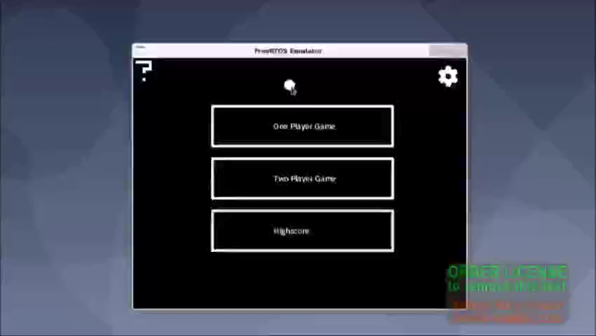
Video/Gameplay
Notes:
5

Slide 6
Main Menu screen
? Button
Setting Button
1 Player
2 Player
Highscore
Notes:
6
If Mouse hovers over ? Button Contolls Settings and functionality of the Items will be shown.
In Settings the level can be chosen and if a Wall needs to be there or not
One Player Game starts the the Normal Snake Game before Game is Started Player Name can be Chosen
Two Player Game starts the advanced Game and before Game started both Players can enter their name
Highscore shows the Highscore
Unlike the other Buttons this will switch into a new State

Slide 7
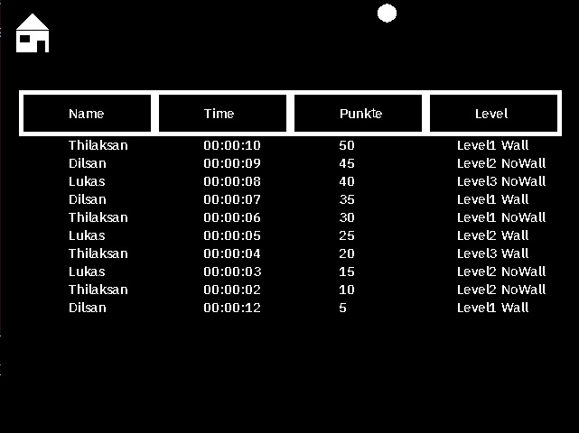
Highscore
Highscoretable
Sorting of Level
Highscore.txt
Import
Export
Notes:
7
Highscoretable, structe of the table head
Last row, only best 10 Player from every level
Structure of the Solo.txt, how the file is saved
Everytime going in Highscore state the Import of the file is happening
Export happens when the game Lost, then check if points allow to add winner player in highscore list

Slide 8
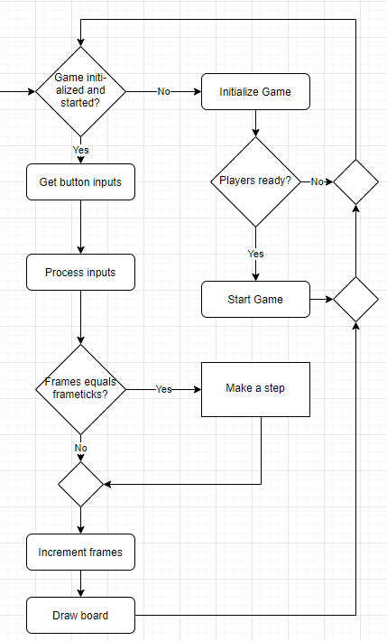
Game
Main Game Loop:
Initialize Level
Get button inputs
Process inputs
Increment frame
Draw the board
Notes:
8

Slide 9
Game
Each Step:
Players make a step
Powerups get created and activated
Collisions of player detected:
Each other
Food
Powerups
Notes:
9

Slide 10
Graphics/ Animation
TumDraw libary
Rectangle, Filledboxes
Level animation
Gameover animation
Notes:
10
TumDraw libary is there to draw any objects (cylce, square, triangle)
Working like jobs after created, delete the job, save it in struct
We used mainly Rectangle for the button and Filledboxed for the snake and wall.
The colors where given by SDL2 libary
As long as the player not start moving, the level animation is working. Everytime it goes throw the while loop, then the next part of the animation is showing on the screen
Gameoverscreen like Level animation only after game is over

Slide 11
Problems and Solutions
Problem: Movement of snake
Opposite direction
Solution: Use of variables
p1/2Direction , p1/2nextDirection
Notes:
11
Square which moves in any direction like „the world‘s hardest game“
First implementation only movement in vertical and horizon direction
Problem was how to fix movement without going in opppsite direction
We used to variables direction1/2 for current direction (UP,DOWN,LEFT,RIGHT) and nextDirection1/2 to check that the opposite direction has no collusion
What happen when too many Inputs?
Because of if cases the order is like this Up, Down, Left, Right

Slide 12
Problems and Solutions
Problem: spawning of new elements takes too long
Select random position in the field, check for collisions with any snake
Go through each snake element by element and check for collision
Takes too long for long snakes
Notes:
12

Slide 13
Problems and Solutions
Solution: fieldArray
One representation of the complete field
Gets updated every step
Contains players, walls, food and powerups
Select random position, check if empty
Notes:
13

Slide 14
Problems and Solutions
Field Array | 0 | 1 | 2 | 3 | 4 | 5 | 6
0 | 0 | 0 | 0 | 0 | 0 | 0 | 0
1 | 0 | 10 | 0 | 1 | 0 | 0 | 0
2 | 0 | 0 | 0 | 1 | 0 | 0 | 0
3 | 3 | 3 | 1 | 1 | 0 | 3 | 3
4 | 0 | 0 | 0 | 0 | 0 | 0 | 0
5 | 3 | 3 | 0 | 0 | 0 | 3 | 3
6 | 0 | 0 | 0 | 0 | 0 | 0 | 0

Slide 15
Problems and Solutions
Running game at the same time with BBB
Slowed gameflow
Occuring of memory acces failure
Heavy flashing
Notes:
15
RTOS Emulator has problems running at the same Time with BBB
Can lead to various Problems, which can be different for every device
Most common problem is theslowed flow of the Game
Other Problem is a memory acces failure which terminates the Game. → Linux on VM
Heavy Flashing can also occur.
In this case pictures of oldFrames will printed the last Frame and the newest Frame

Slide 16
Any Questions?
Notes:
16

